Slide 1
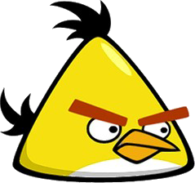
Wiosna - Spring
Signs of spring
For example:
The birds are singing …
… Even if these two don’t.

Slide 2
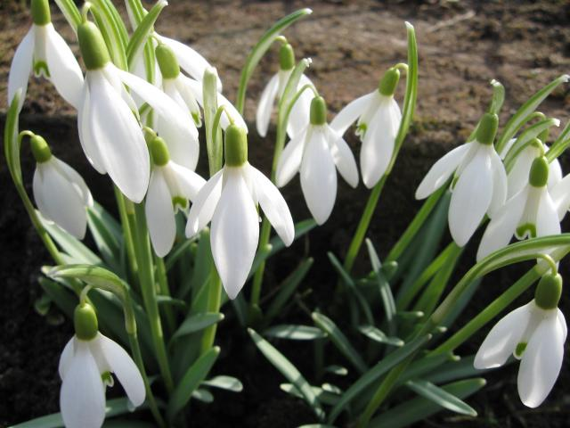
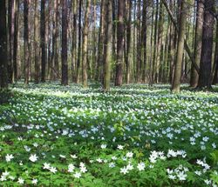
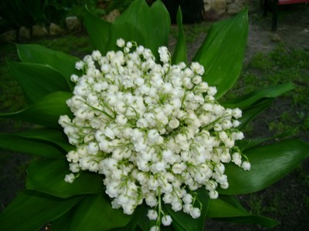
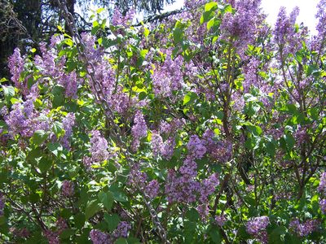
Plants
snowdrops - przebiśniegi
anemones - zawilce
lily of the valley - konwalia
lilac – bez

Slide 3
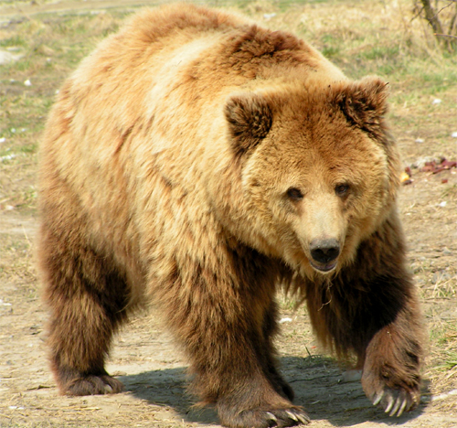
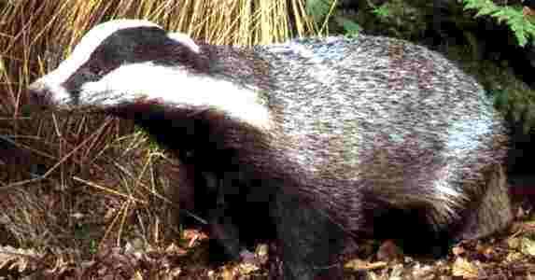
waking from hibernation
bear – niedźwiedź
badger - borsuk

Slide 4
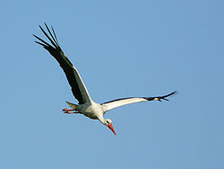
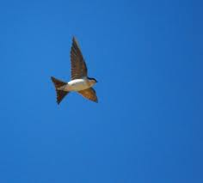
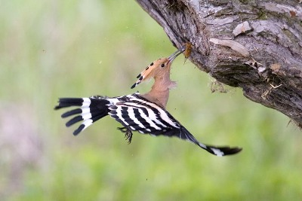
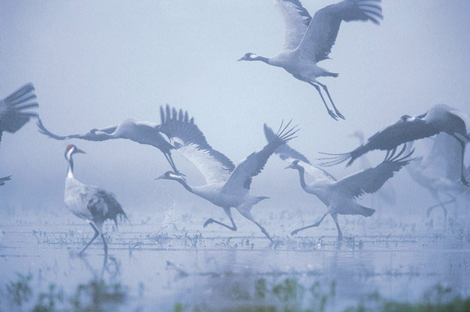
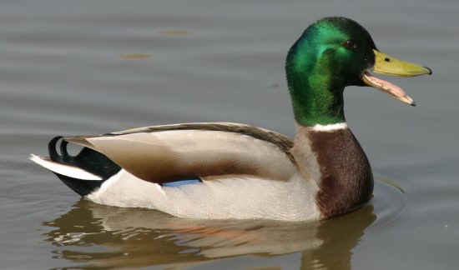
Arrival of birds
stork - bocian
swallow - jaskółka
dolt - dudek
duck - kaczka
crane - żuraw

Slide 5
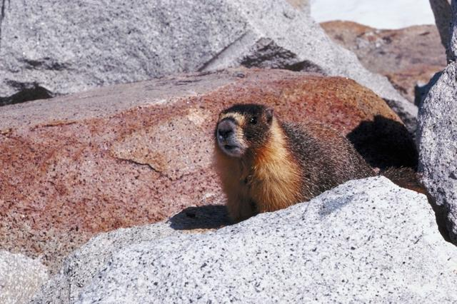
Groundhog Day
marmot - świstak
Groundhog Day is a day celebrated on February 2. According to folklore, if it is cloudy when a groundhog emerges from its burrow on this day, then spring will come early. If it is sunny, the groundhog will supposedly see its shadow and retreat back into its burrow, and the winter weather will continue for six more weeks.

